Slide 1
Lecture-6-11 Unit-2
Virtualization Technology

Slide 2

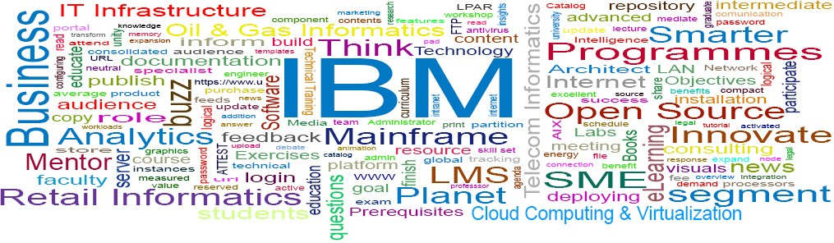
IBM ICE (Innovation Centre for Education)
Welcome to:
Server and Storage Virtualization
© Copyright IBM Corporation 2016
9.1

Slide 3
Unit objectives
IBM ICE (Innovation Centre for Education)
After completing this unit, you should be able to:
Identify the types of server virtualization
Explain hardware assisted virtualization
Define and describe hypervisors
Explain Desktop virtualization
Differentiate between the types of desktop virtualization
Understand Storage virtualization
Identify the types of Storage virtualization

Slide 4
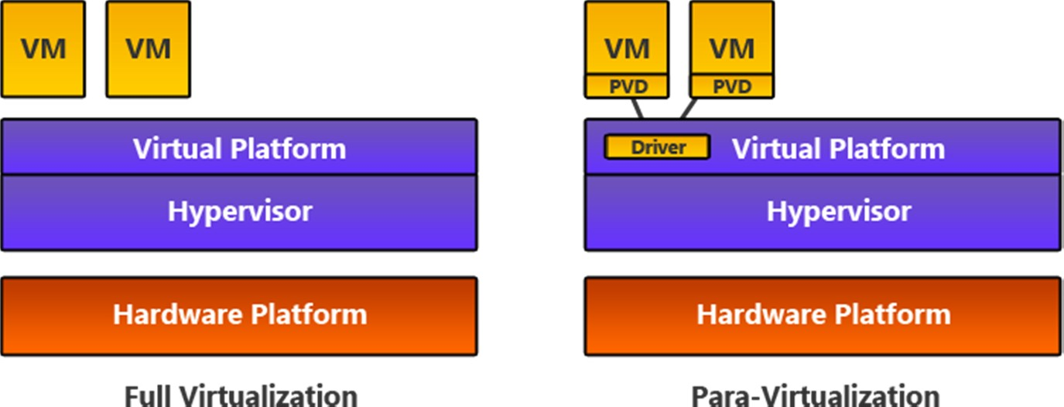
Types of Server Virtualization (1 of 3)
IBM ICE (Innovation Centre for Education)

Slide 5
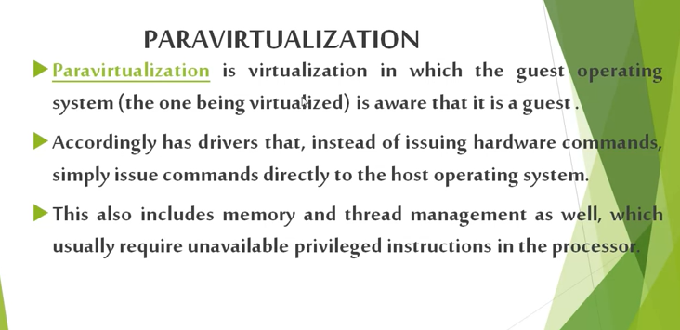

Slide 6
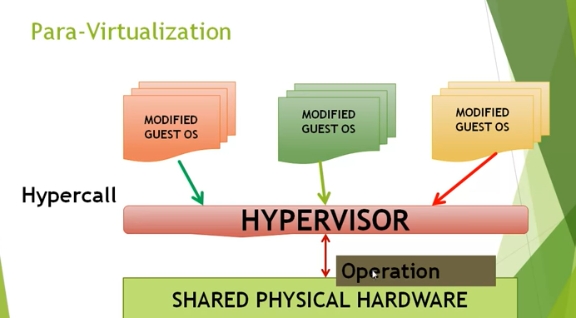

Slide 7
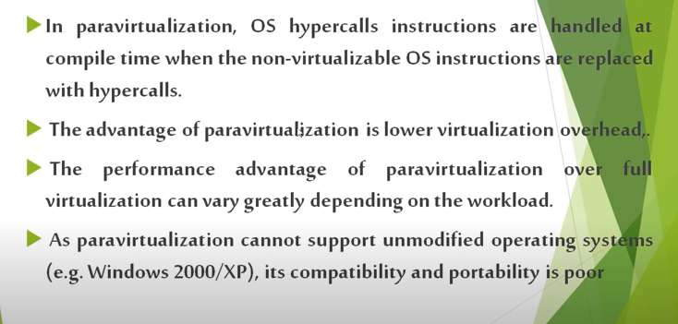

Slide 8
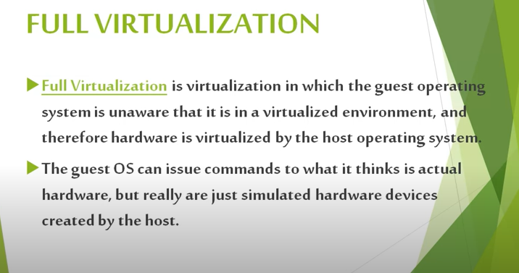

Slide 9
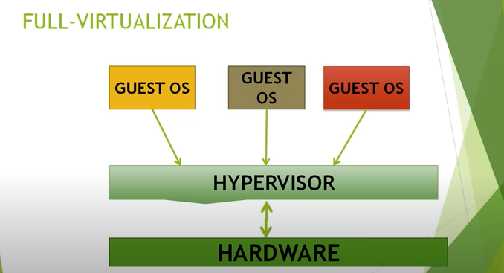

Slide 10
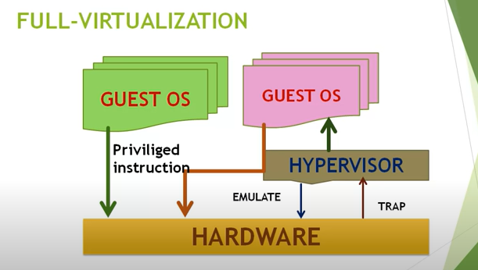

Slide 11
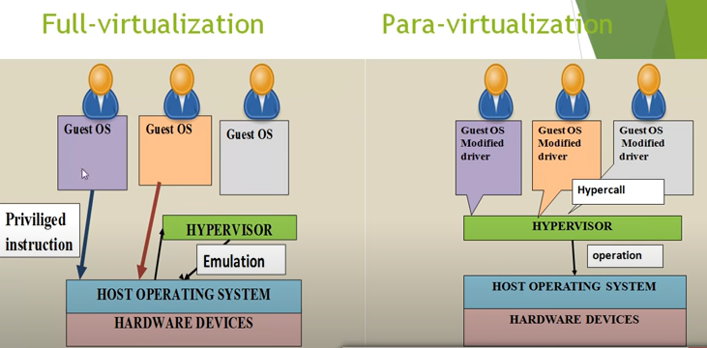

Slide 12
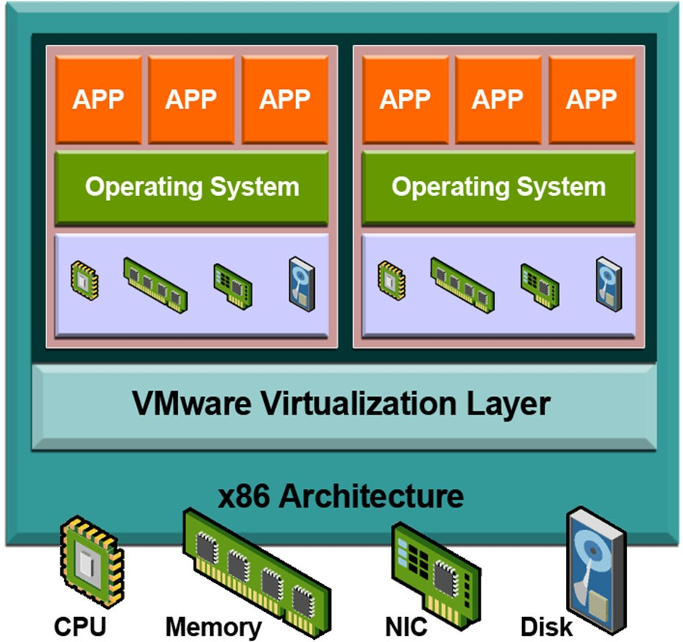
Simulation
IBM ICE (Innovation Centre for Education)
.

Slide 13
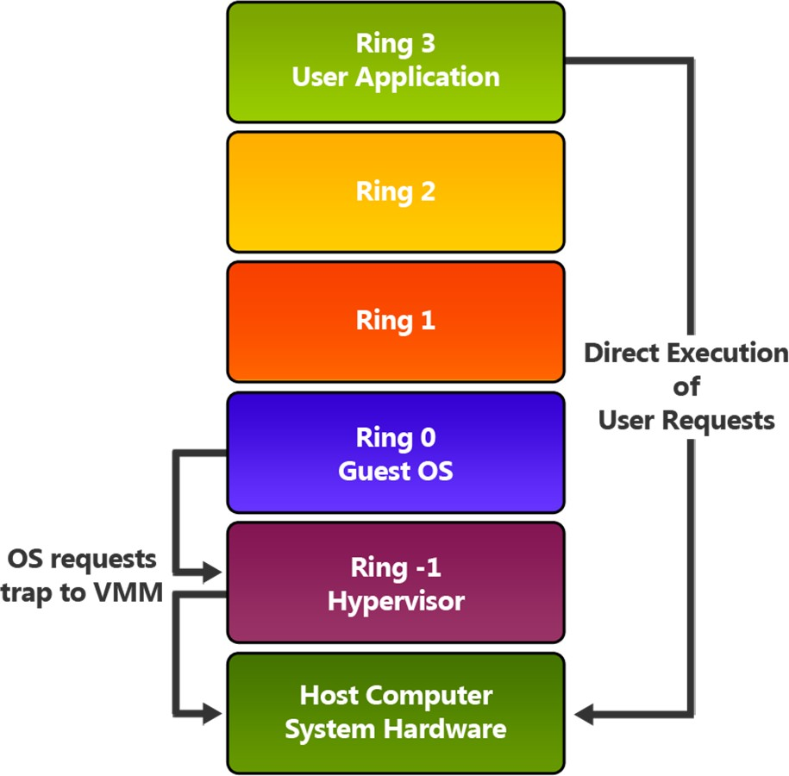
Hardware Assisted Virtualization (1 of 2)
IBM ICE (Innovation Centre for Education)

Slide 14
Hypervisor
A hypervisor or virtual machine monitor (VMM) is computer software, firmware or hardware that creates and runs virtual machines. A computer on which a hypervisor runs one or more virtual machines is called a host machine, and each virtual machine is called a guest machine.
It is the part of the private cloud that manages the virtual machines, i.e. it is the part (program) that enables multiple operating systems to share the same hardware. Each operating system could use all the hardware (processor, memory) if no other operating system is on. That is the maximum hardware available to one operating system in the cloud.

Slide 15
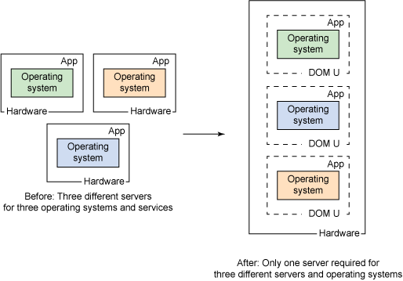
the hypervisor is what controls and allocates what portion of hardware resources each operating system should get, in order every one o them to get what they need and not to disrupt each other

Slide 16
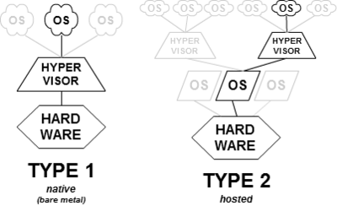
Type-1, native or bare-metal hypervisors: These hypervisors run directly on the host's hardware to control the hardware and to manage guest operating systems
Type-2 or hosted hypervisors: These hypervisors run on a conventional operating system (OS) just as other computer programs do. A guest operating system runs as a process on the host.

Slide 17
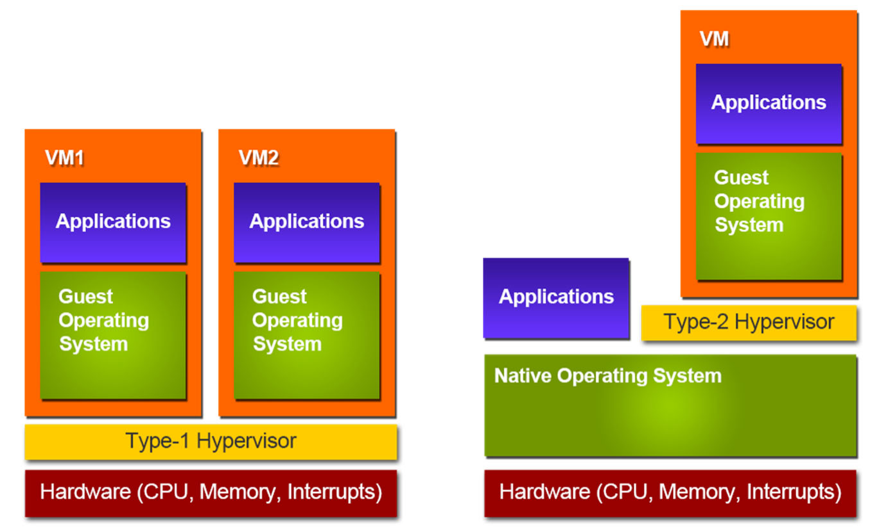
Types of Hypervisors
IBM ICE (Innovation Centre for Education)
Type 1 Hypervisors
Type 2 Hypervisors

Slide 18
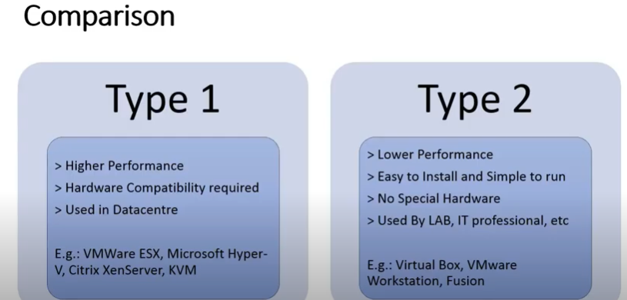

Slide 19
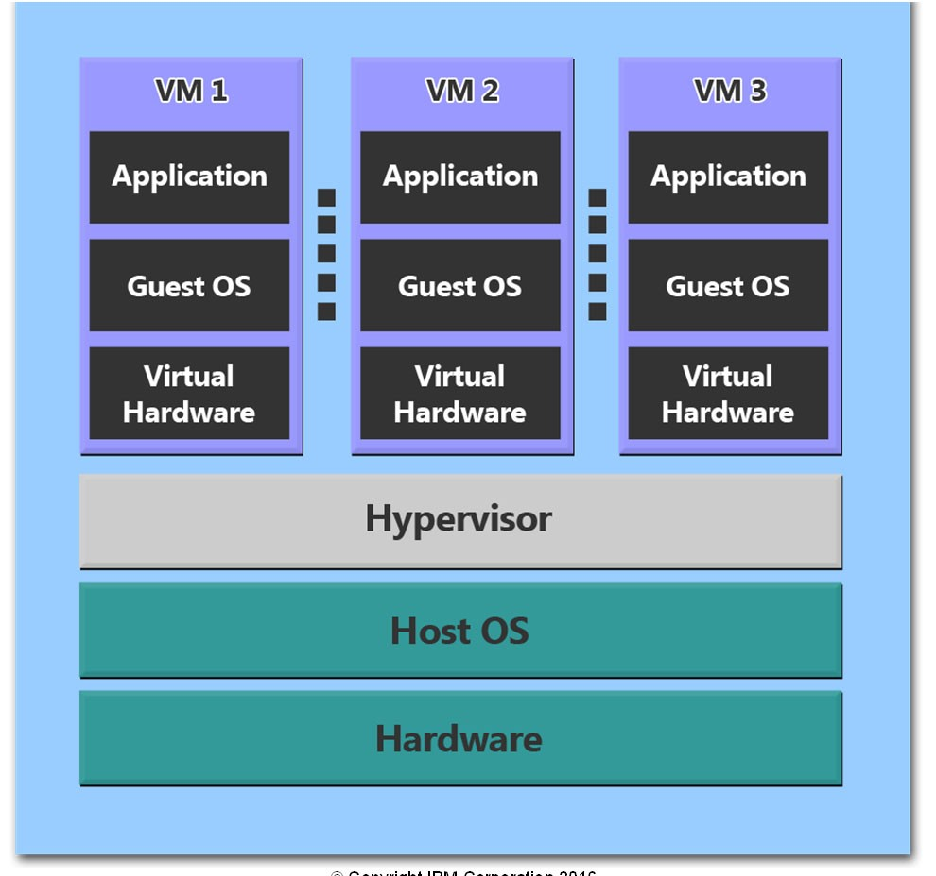
Hypervisors
IBM ICE (Innovation Centre for Education)

Slide 20
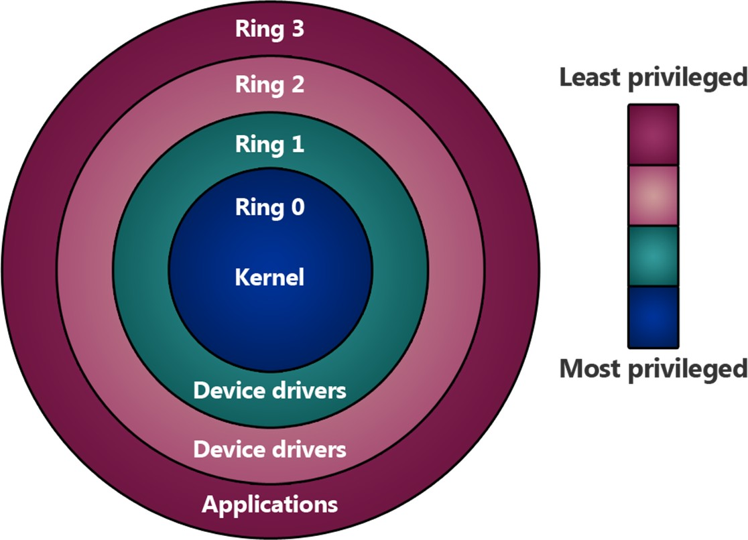
Ring levels on x86 processors
IBM ICE (Innovation Centre for Education)

Slide 21
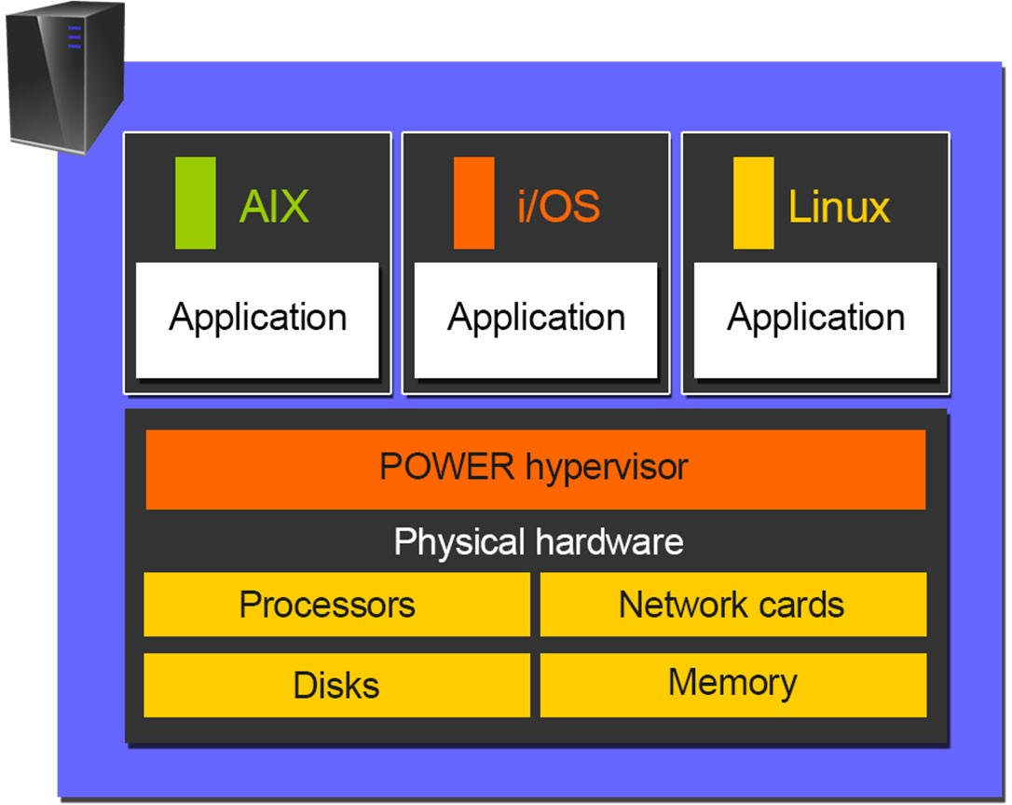
IBM PowerVM Hypervisors
IBM ICE (Innovation Centre for Education)

Slide 22
Common considerations in server
virtualization
IBM ICE (Innovation Centre for Education)
SPOF in Server Virtualization: When companies replace multiple physical servers with virtual machines (VMs) that run on a single physical server, the hypervisor and the physical server on which it runs become a single point of failure (SPOF). Worse yet, the SPOF is not limited to only one server; it extends to all of the VMs hosted on that server
Patch Management: Patch management is the process of distributing and applying updates to software. These patches are often necessary to correct errors (also referred to as “vulnerabilities” or “bugs”) in the software.
Migration of existing IT infrastructure
Licensing
Legacy/Proprietary Applications

Slide 23
Single Point of Failure (SPOF)
A single point of failure (SPOF) is a critical system component with the ability to cease system operations during failover. SPOFs are undesirable to systems requiring reliability and availability, such as software applications, networks or supply chains.
In computing, SPOFs are identified and resolved through redundant and high-availability clusters.
For example, upon machine failure, another machine immediately assumes lost functions and responsibilities. Similar redundancy designs are often employed at internal component levels.
At system levels, multiple machines or systems provide required redundancy. Replication is used at the site level, where another site or location is prepared to take over in the event of sudden site access failure.
Highly reliable systems are designed without SPOFs. This means that failure of a component, system or site does not halt system or operational functions.

Slide 24
Patch Management
Common areas that will need patches include operating systems, applications, and embedded systems (like network equipment). When a vulnerability is found after the release of a piece of software, a patch can be used to fix it. Doing so helps ensure that assets in your environment are not susceptible to exploitation.
Why do we need patch management?
Security: Patch management fixes vulnerabilities on your software and applications that are susceptible to cyber-attacks, helping your organization reduce its security risk.
System uptime: Patch management ensures your software and applications are kept up-to-date and run smoothly, supporting system uptime.

Slide 25
Patch Management
Compliance: With the continued rise in cyber-attacks, organizations are often required by regulatory bodies to maintain a certain level of compliance. Patch management is a necessary piece of adhering to compliance standards.
Feature improvements: Patch management can go beyond software bug fixes to also include feature/functionality updates. Patches can be critical to ensuring that you have the latest and greatest that a product has to offer.

Slide 26
Physical Machine to Virtual Machine (P2v) Conversion
A VM maintains a relationship between various virtual machines, and between a hypervisor and a VM in a grouped server environment.
Physical to VM exchange is a procedure via which a physical machine is transformed into a virtual machine. When transforming a physical machine, the ‘converter application’ (Converter) copies data on the hard disk of the source machine and shifts that data to the target virtual disk.
Advantages of P2V converters are:
1. Runs migration among heterogeneous hardware
2. Minimizes time required to set up a new virtual machine
3. Permits migration of machines to a new hardware without re-launching the
application or operating system

Slide 27
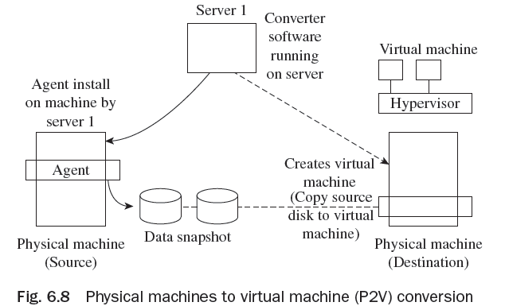
Physical Machine to Virtual Machine (P2v) Conversion
The P2V ‘converter application’ comprises three constituents—converter server, converter agent, and converter boot CD.
There are two means to shift from physical machine to virtual machine (VM). These are cold migration and hot
migration.

Slide 28
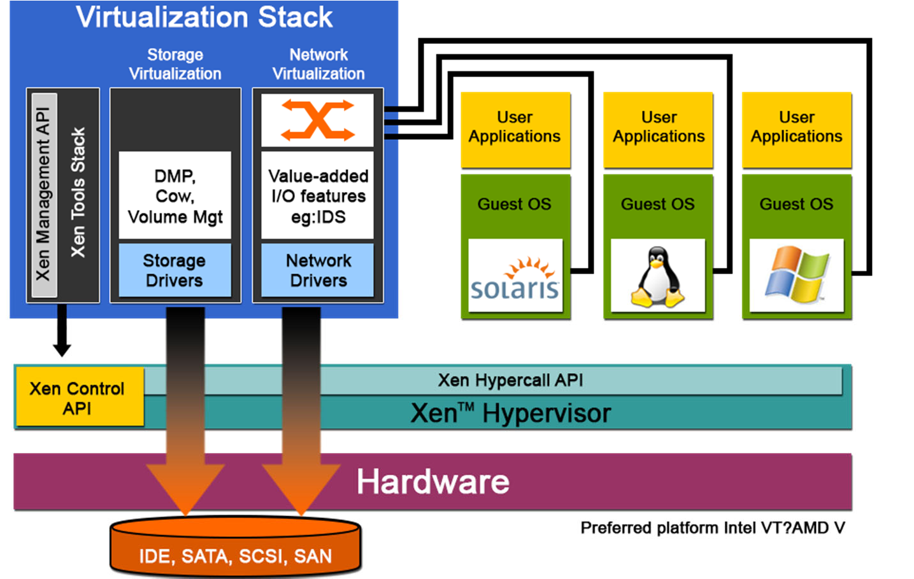
Anatomy of server virtualization
IBM ICE (Innovation Centre for Education)

Slide 29
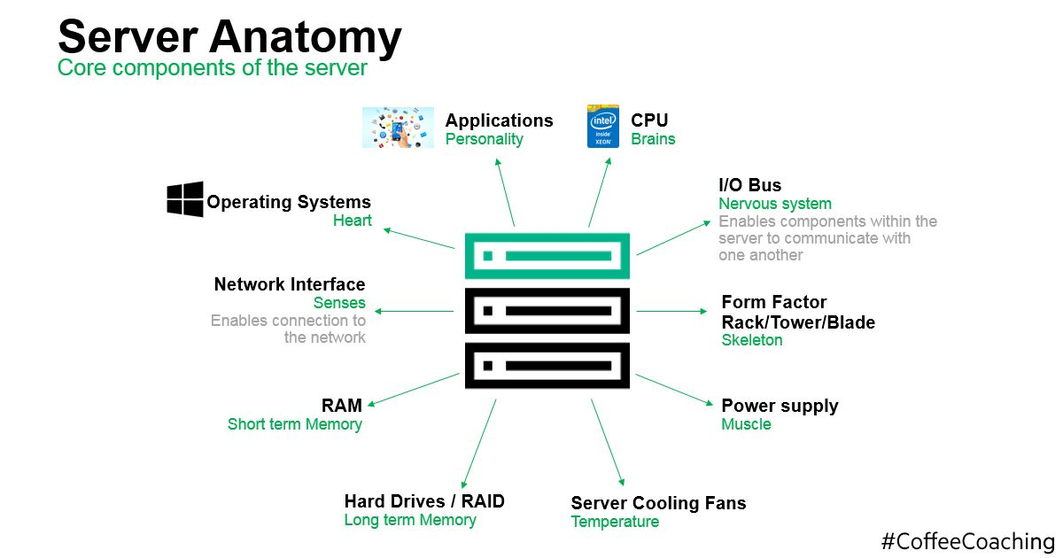

Slide 30
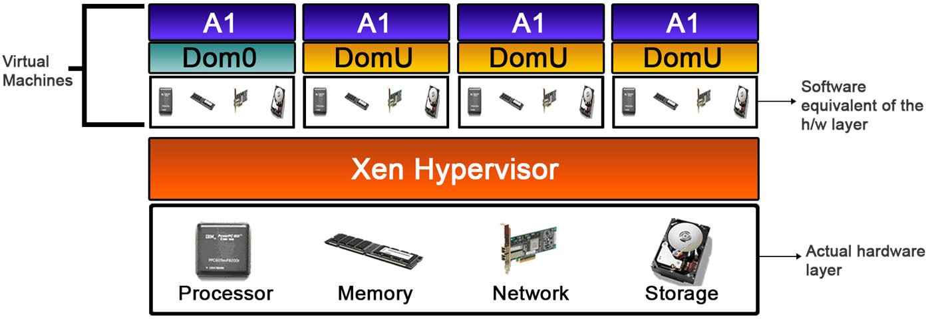
Three major layers in Xen Server
IBM ICE (Innovation Centre for Education)
Hardware Layer
Hypervisor
Domains Layer

Slide 31
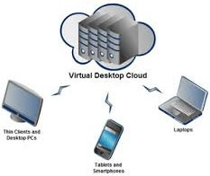
Desktop Virtualization
IBM ICE (Innovation Centre for Education)
Desktop virtualization refers to the technique of creating an abstraction of desktop clients or end-user computing equipment.
This is not very different from virtualizing a physical server.
The process involves creating a logical abstraction or a virtual image of the desktop and placing it on a centralized physical server.

Slide 32
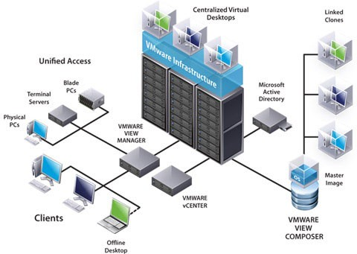
How desktop virtualization works?
IBM ICE (Innovation Centre for Education)
Source: http://www.ipexpert.gr

Slide 33
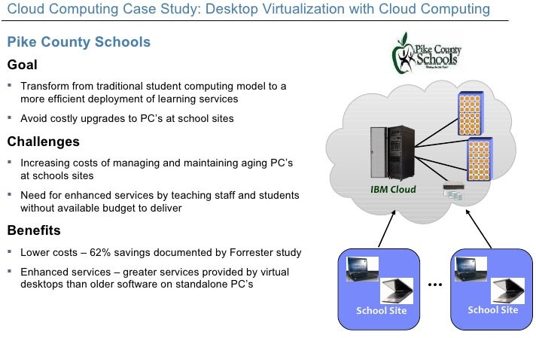
Benefits of Desktop Virtualization
IBM ICE (Innovation Centre for Education)

Slide 34
Constraints in Desktop Virtualization
IBM ICE (Innovation Centre for Education)
Network bandwidth
Security of the network
Graphic Intensive Applications
Application requires direct access to peripherals debuggers /programmers used in the hardware design sector that in turn require direct access to host connected serial, USB ports are not well tested on VDI.

Slide 35
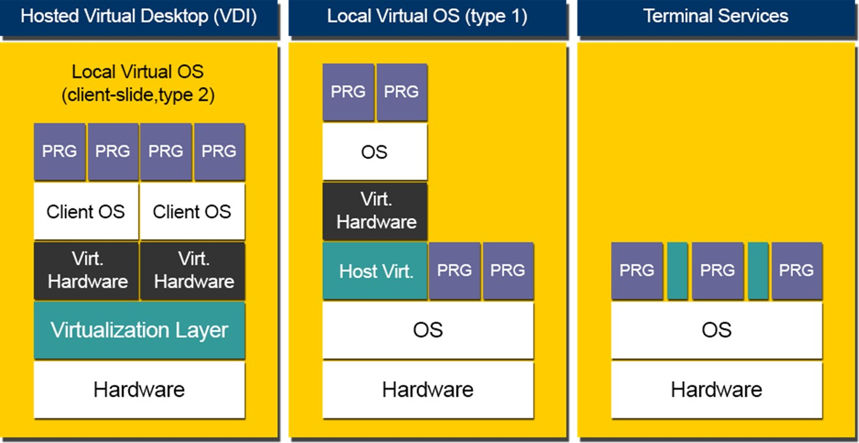
Types of Desktop Virtualization
IBM ICE (Innovation Centre for Education)

Slide 36
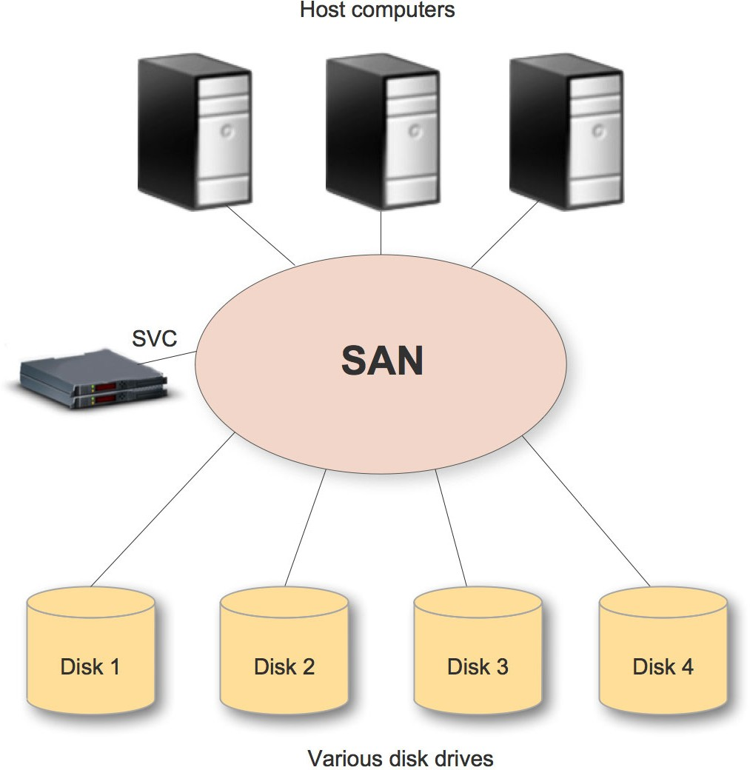
Storage Virtualization Overview
IBM ICE (Innovation Centre for Education)

Slide 37
Benefits of storage virtualization
IBM ICE (Innovation Centre for Education)
Major shortcomings of the conventional storage systems
Interoperability
Manageability
Scalability

Slide 38
Features in the logical layer
IBM ICE (Innovation Centre for Education)
Features built into the logical layer may vary from vendor to vendor, but almost all of them ensure the following:
Interoperability
Manageability
Scalability

Slide 39
Types of Storage Virtualization
IBM ICE (Innovation Centre for Education)
Commonly used protocols for storage in the industry are classified broadly in three categories:
Host based storage virtualization
Storage based virtualization
Network based
Hybrid model

Slide 40
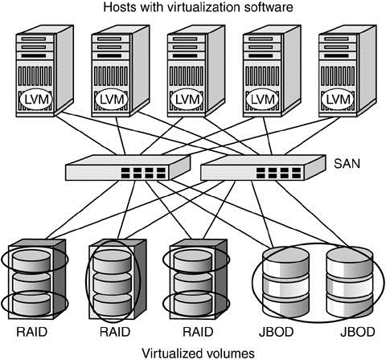
Host based mirroring
IBM ICE (Innovation Centre for Education)

Slide 41
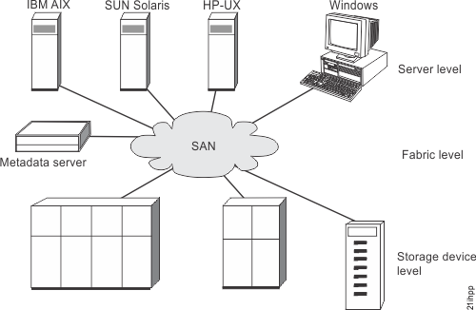
Storage level virtualization
IBM ICE (Innovation Centre for Education)

Slide 42
Storage Area Network
Storage area network (SAN) refers to the LAN design for managing huge amounts of data transfer.
It uses interconnection technology for supporting data storage, retrieval, and replication. NAS works on TCP/IP, whereas SAN for disk blocks transformation works on low-level network protocols.
Storage area networks are actually designed for data management. It is a rapid storage device network and can be connected with servers.
SAN is helpful for transferring data from one storage device to another without disturbing other devices.
SAN also supports fast backup as CPU cycles of server are not involved in the backup process. At the time of recovery, SAN plays an important role.

Slide 43
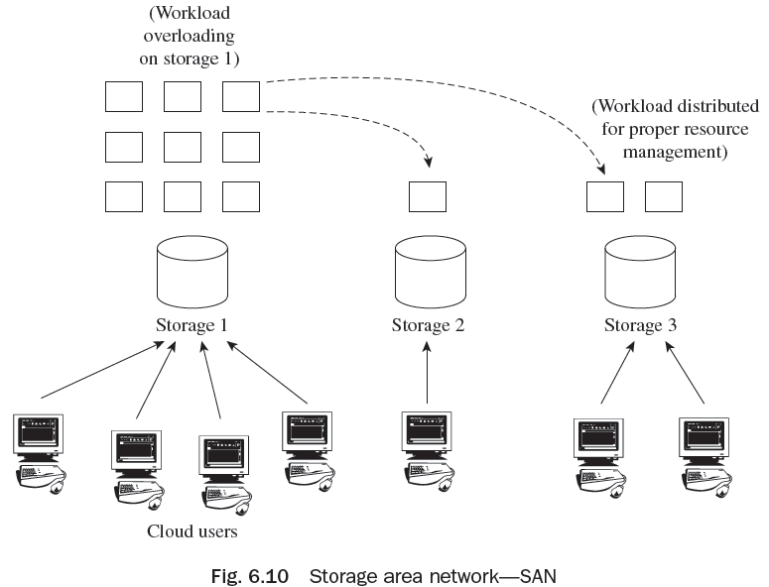
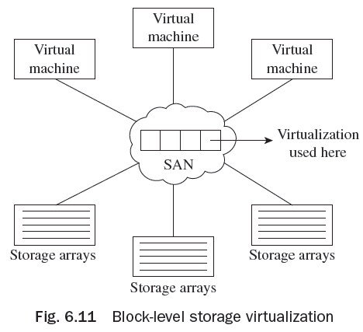
Storage Area Network

Slide 44
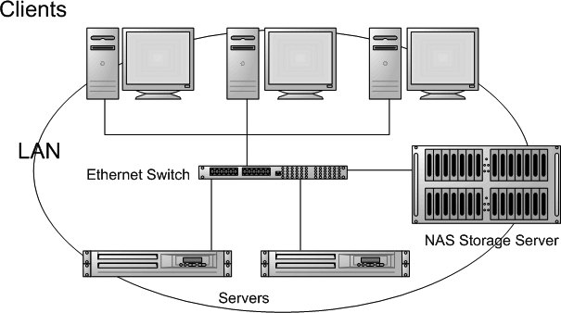
Network based storage virtualization
IBM ICE (Innovation Centre for Education)
Network Attached Storage

Slide 45
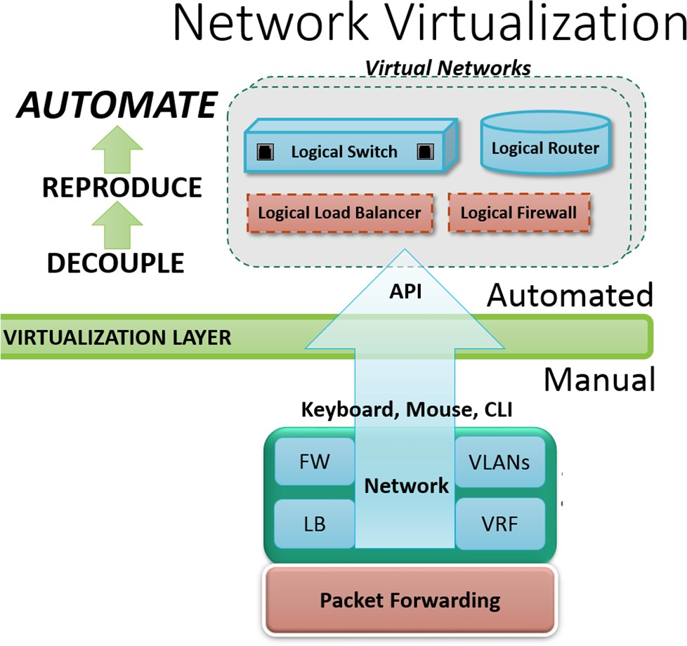
Network virtualization overview
IBM ICE (Innovation Centre for Education)

Slide 46
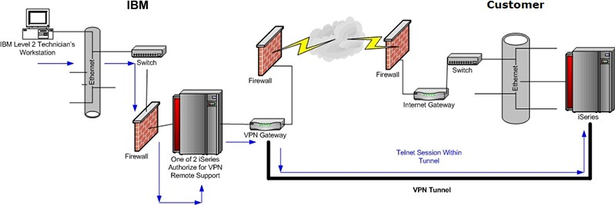
Virtual Private Network (VPN)
IBM ICE (Innovation Centre for Education)

Slide 47
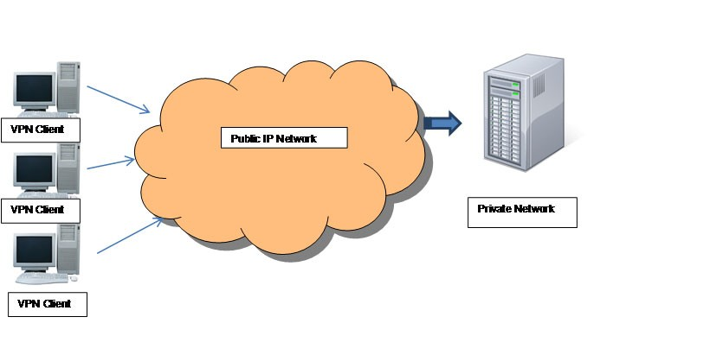
How VPN works
IBM ICE (Innovation Centre for Education)
VPN connect remote users with their central company servers over the public network while maintaining security and confidentiality of data that is being transmitted. This gives the effect of being connected directly to the company LAN.
VPN does not require any dedicated leased lines to maintain confidentiality. VPN creates a logical network over and above the physical public network that is already in place.
This is achieved through a range of technologies that are available from Layer-1 to the application layer of the network protocol stack.
All operations that can be performed on the company LAN can be performed on the VPN as well.

Slide 48
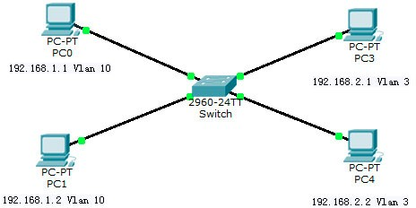
Virtual LAN (VLAN)
IBM ICE (Innovation Centre for Education)

Slide 49
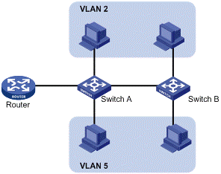
Advantages of VLAN
IBM ICE (Innovation Centre for Education)
Manageability
Data Sharing
Tracking Usage
Reduction of broadcast traffic on switch
VLANs are also used to share a high
network bandwidth channel among several different VLANs
Server Virtualization and VLAN

Slide 50
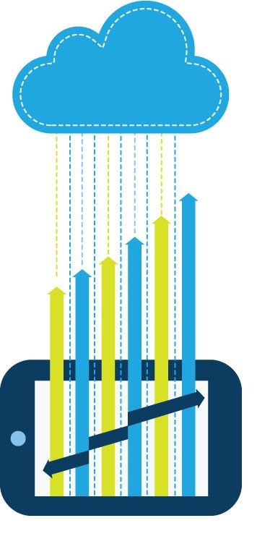
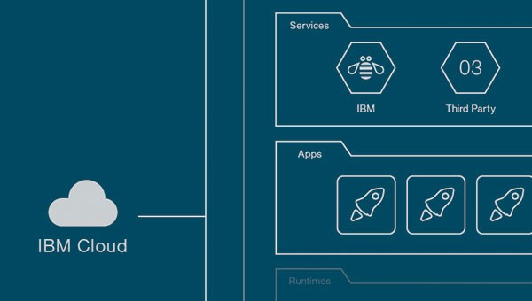
Challenges in using applications in
traditional install, use and update model
IBM ICE (Innovation Centre for Education)

Slide 51
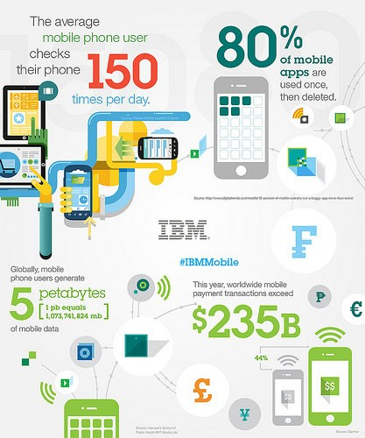
Solution for challenges
IBM ICE (Innovation Centre for Education)

Slide 52
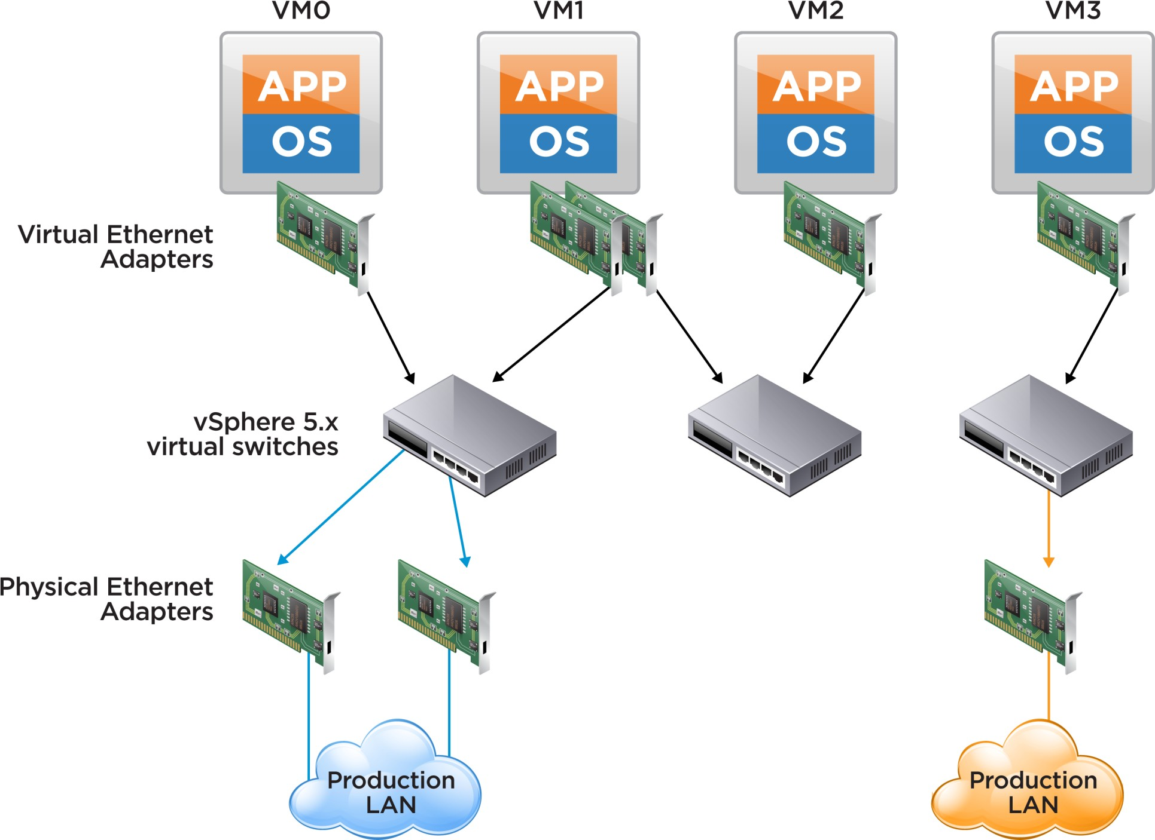
Architecture
IBM ICE (Innovation Centre for Education)
Image source: labs.vmware

Slide 53
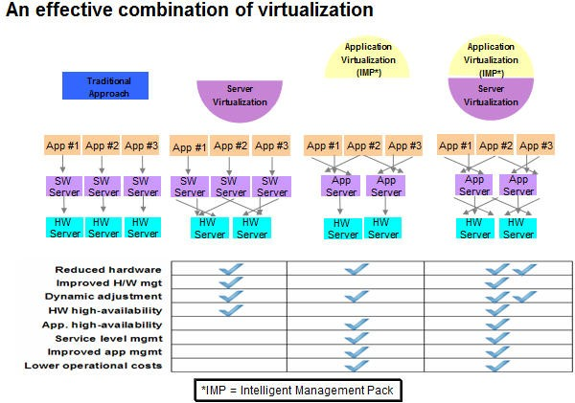
Benefits of application virtualization
IBM ICE (Innovation Centre for Education)

Slide 54
Checkpoint (1)
IBM ICE (Innovation Centre for Education)
These are common shortcomings of physical infrastructures : Asset Management, Tracking Utilization, Security and Compliance, Provisioning, Staff for Administration, Sizing, Optimization.
True
False
Partial True and Partial False.
The code (software) is logically equivalent to a hardware processor.
A storage that can be converted into an iso9660 software image.
4. Native Virtualization, Para-Virtualization, OS Virtualization, Application Virtualization are classification of Virtualization
a.
b.
based on the extent of hardware emulation
based on the technology or the area that is being virtualized – Server, Storage,
Network
a and b
c.
d.
none of above.

Slide 55
Checkpoint (2)
IBM ICE (Innovation Centre for Education)
The earliest pioneer company of modern virtualization technology was and it invented virtualization more than 40 years ago.
Intel introduced Intel VT-x and AMD introduced AMD-V to support in hardware.
eliminates most of the inflexibilities inherent in the hardware systems and allows for better manageability leading to a better utilization of the system.
The is responsible for allocating memory, CPU resources, network and storage to each virtual machine.

Slide 56
Checkpoint (3)
IBM ICE (Innovation Centre for Education)
, , and are the three major layers in a Xen Server.
creates an abstraction over the disks in the form of logical volumes and volume group.
provides a file system level abstraction of the storage, i.e. the remote storage file system can be locally mounted by a host as any other file system.
NAS
SAN
Both NAS and SAN
refers to the components built into the host server operating system and the host hardware to enable storage virtualization.

Slide 57
Checkpoint (4)
IBM ICE (Innovation Centre for Education)
Storage based virtualization refers to the use of exclusive storage protocols to access storage systems.
host-dependent
guest-dependent
host-independent
guest-independent
Major shortcomings of the conventional storage systems are :
Interoperability, Reliability and Scalability
Interoperability, Manageability and Scalability
Security, Reliability and Reusability
None
In a , the desktop virtual machines are kept on a central server. The end-user equipment could be a thin-client capable of presenting a remote display to the end-user, very similar to a RDP protocol client. The hosted virtual desktops may be provisioned on-demand, be maintained in current configuration for longer runs, or be saved and archived in a desktop-repository on the server.
KVM is enabled only in the presence of Intel VT-x hardware on Intel platforms or AMD-V feature on AMD platforms.
True
False
Can be true or false, depends on type of OS.

